Slide 1







PARALLEL COMPUTING USING OPENMP
PROCEDURAL TERRAIN GENERATION
2023BCS0011 : Vipin Karthic
2023BCS0020 : Sanjay

Slide 2



PROJECT OVERVIEW AND ABSTRACT
This project focuses on creating and parallelizing a procedural terrain generation system that simulates realistic landscapes using Voronoi based heightmap generation with Fractal Brownian Motion, particle based hydraulic erosion simulation, flow accumulation based river generation, climate/moisture map creation, biome classification, and density based object placement
The terrain generation process involves calculations across millions of independent points, making it perfect for parallelization. Analysis showed a speedup of 1.8x to 6.7x on large terrains, which used multi parallel BFS, thread local buffer accumulation, and other algorithms
The final output is the ppm files of River Map, Height Map and the Biome Map which can be then just used directly in a GameEngine to generate the terrain

Slide 3

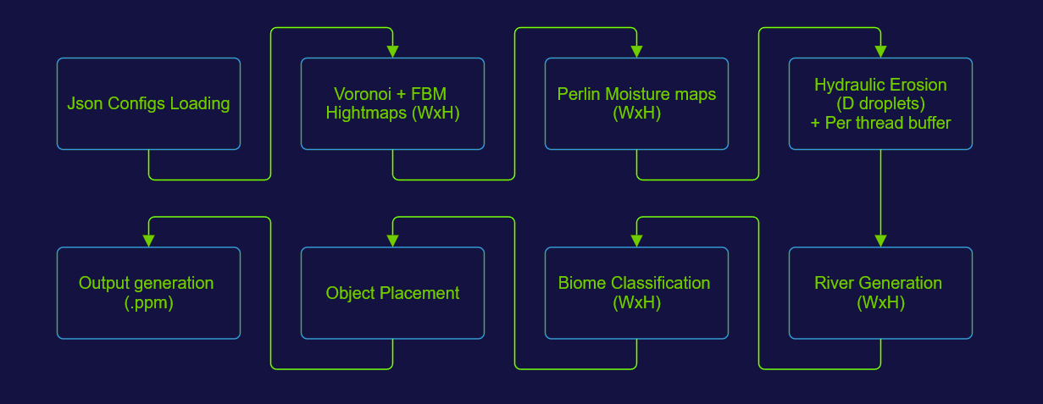


ARCHITECTURE

Slide 4
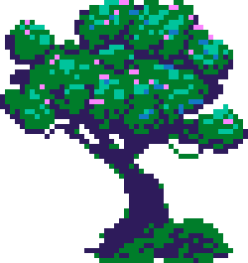

IMPLEMENTATION
PROJECT FILES (MOST IMPORTANT):
BiomeClassifier.h, BiomeHelpers.h, BiomeSystem.h
Biome definitions, classification algorithms, and utilities
HydraulicErosion.h, ErosionParams.h
Particle-based erosion simulation system
PerlinNoise.h, WorldType_Voronoi.h
Noise generation and heightmap creation
RiverGenerator.h
Flow direction, accumulation and river carving
ObjectPlacer.h
Biome-based object distribution system
Types.h
Custom data structures (Grid2D<T>)
util.h
Utility functions, image writers

Slide 5
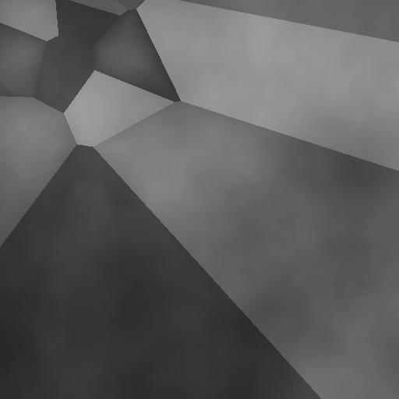
IMPLEMENTATION
MAIN CODE FLOW
The jsons are read, which contain the configs of the world we are trying to generate
Using the config values, a Voronoi Map is created
We first create random plates on the map, each with its own position, height, and weight scale
For every pixel, it we find the closest and second closest plate to make sure the plates are smooht at boundaries
Then we use this to generate height with FBM noise for natural detail, applies a contrast curve, and normalizes the result to 0–1
After this process is over we have the heightmap which is ready

Slide 6
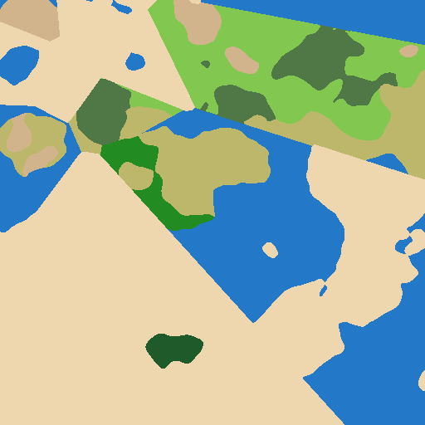
IMPLEMENTATION
MAIN CODE FLOW
Now, a moisture map is created using a PerlinNoise vector, which is then used to classify Biomes
Using the new moisture map and the Height Map generated, a basic biome classification is done in order to show the progress

Slide 7
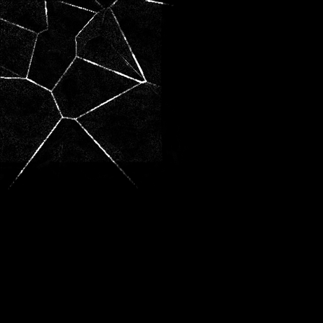
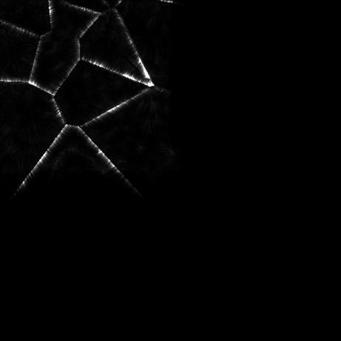
IMPLEMENTATION
MAIN CODE FLOW
Now we start with Hydraulic Erosion, which generates a new detailed terrain with features :
We start with approximately (.4*x*y) droplets, which are placed at random (x,y) positions across the map with their own PRNG determined values such as speed, intertia etc
Each droplet is simulated per step which calculates the amount of height eroded, while at each step the droplet evaporates a little bit and sediments a little bit
Each droplet’s downhill potential is calculated which is then used to calculate the new speed, the slope and the sediment capacity its carrying
It starts depositing once it reaches the point where it cannot carry any more sediment
Finally once the droplets are finished, each droplet contributes its changes to the main Heightmap

Slide 8
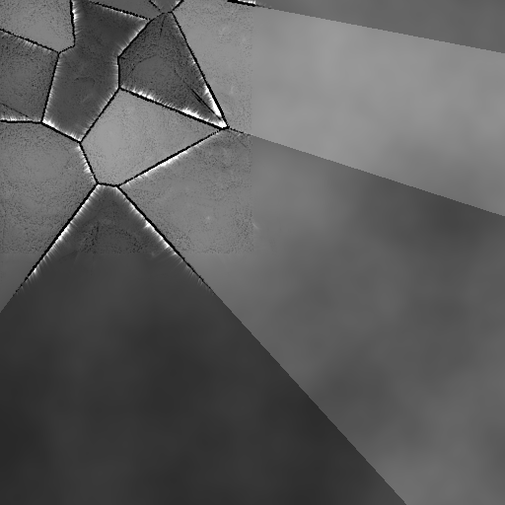
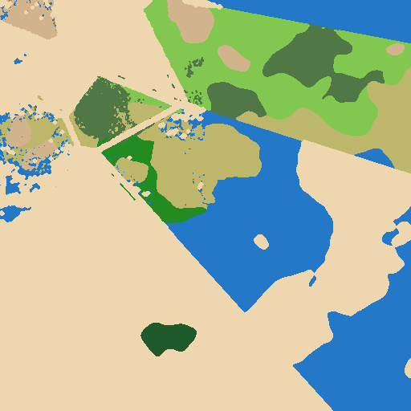
IMPLEMENTATION
MAIN CODE FLOW
Now with the updated Heightmaps, another Biome Classification is done to show the changes

Slide 9
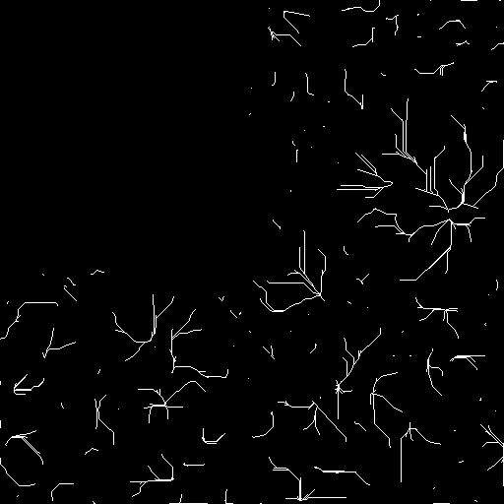
IMPLEMENTATION
MAIN CODE FLOW
Now finally using the updated Heightmaps, we generate Rivers to finish the terrain, which then modifies the heightmap and the biomes to generate the final output :
The flow direction, flow accumulation and rivermask maps are created,
Now for each cell, the 8 neighbors are checked and the one with the highest downhill slope is picked, and is stored in the flow direction
Now for each cell, the cells are processed from descending heights to simulate the process of water flowing from the highest point to lowest point, and each cell starts with 1 unit of water which is then slowly adds it to the cell it points to and finally the total upstream water is stored somewhere
Now for each cell which has more than the river threshhold, it is marked as a rivercell in the rivermask map
Now we perform a BFS from all the rivercells to and a distance map is updated for every cell to its nearest river cell
Finally the cells with proper distance is carved as river and the heightmap is modified to show the carving of the river which is a gradient

Slide 10
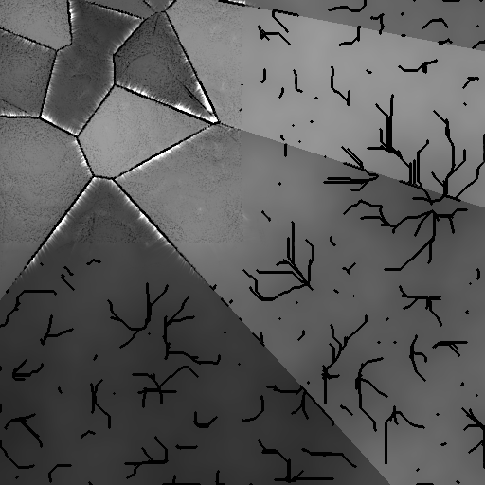
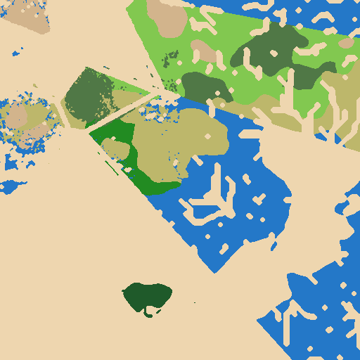
IMPLEMENTATION
MAIN CODE FLOW
Finally the final output is generated : The Heightmap, The Biomemap

Slide 11


FUTURE SCOPE
We are planning to add the following optimizations in the future :
Using SIMD vectorization will allow improvements in almost all the stages
BFS optimization
Instead of using the normal algoithm an optimized version can be used for this case
Using top down BFS for early levels and bottom-up BFS for larger levels
This will reduce edge examination by around 2-3x
Switching to a GPU based implementation will change the resuts completely
Due to having 1000s of cores, better memory bandwidth, Texture units and Tensore cores the speedup of our project if implemented through CUDA will improve by around 18x with easy, (This is based on 4060 and approximate number of operations performed)’
This also enables us to create real time proc gen which opens a new world of possibilities in game development

Slide 12



OPENMP PARALLELIZATION
01
HYDAULIC EROSION
02
RIVER GENERATION
03
BIOME CLASSIFICATION

Slide 13

RESULTS AND ANALYSIS (2048 X 2048 )

Slide 14
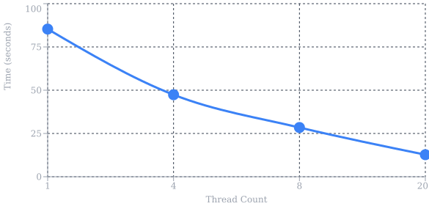

Slide 15
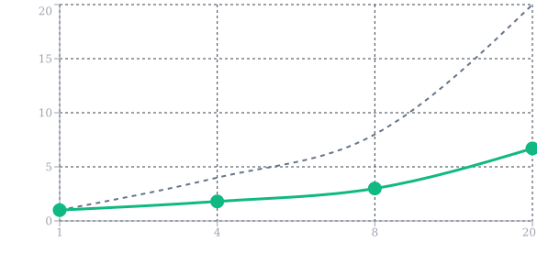

Slide 16
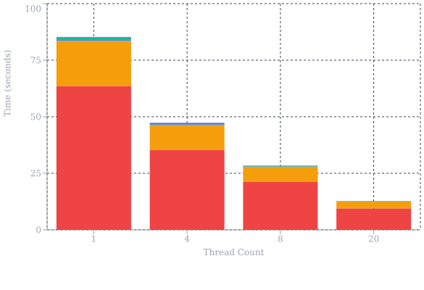

Slide 17
CONCLUSION

Slide 18
THANK YOU

